Slide 1
3D House
(Exterior) Design
Progress Report

Slide 2
Presented By
Joy Pal – 201002418
Jakir Hossain - 201002050
Group - 13

Slide 3
Exterior Design
Consistent with your surroundings
Reduces the impact on your site's landform
Makes the most of solar access and other natural features.

Slide 4
Objectives
To learn the high level architecture design.
To learn the various tools of AutoCAD software.

Slide 5
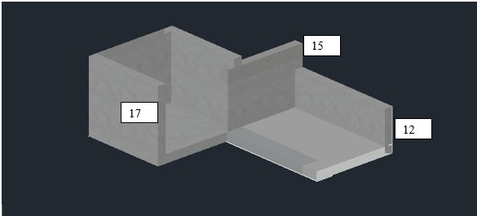
Implement

Slide 6
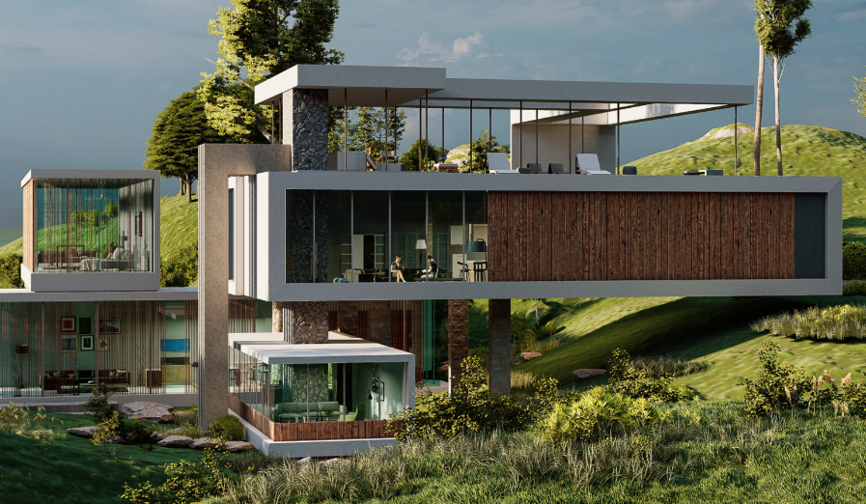
Final Look

Slide 7
Description
Using AutoCAD 2022 Software.
Need more 1 week to complete.
https://www.artstation.com/artwork/ZGY4g1

Slide 8


